Slide 1
Carmi, a Swiftie, wanted to get a sense if certain actions / announcements by her idol Taylor led to more streaming activities.
Moreover, using the same data, she wanted to explore if there are certain Philippine artist/s who are better suited as front act for Taylor’s concert in the country should she decide to hold one here.
Categories:
Album Announcement
Album Release
Single Announcement
Single Release
Tour Announcement
Tour Launch
Awards
Other News
Observe changes on Total Streams and Amount of Songs on Daily Charts.
Case
Front Act History
Genre
Act Type (Solo or Group)
Popularity

Slide 2
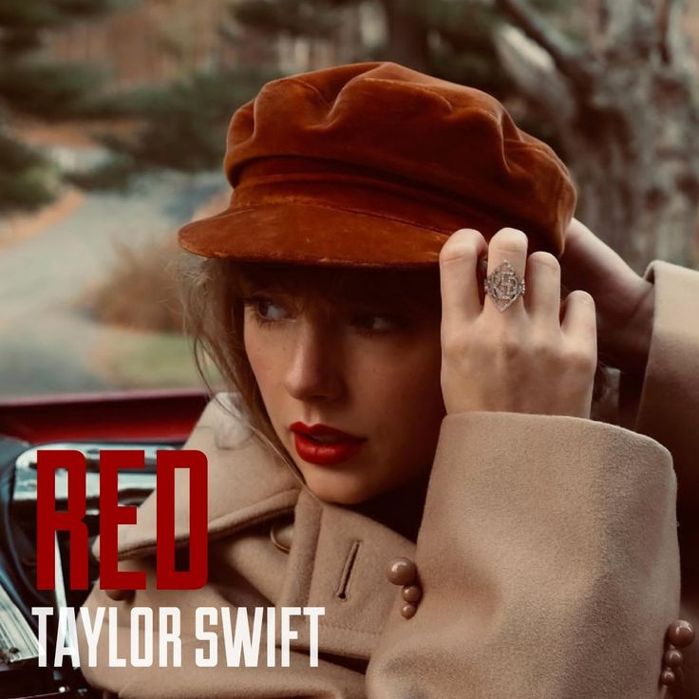
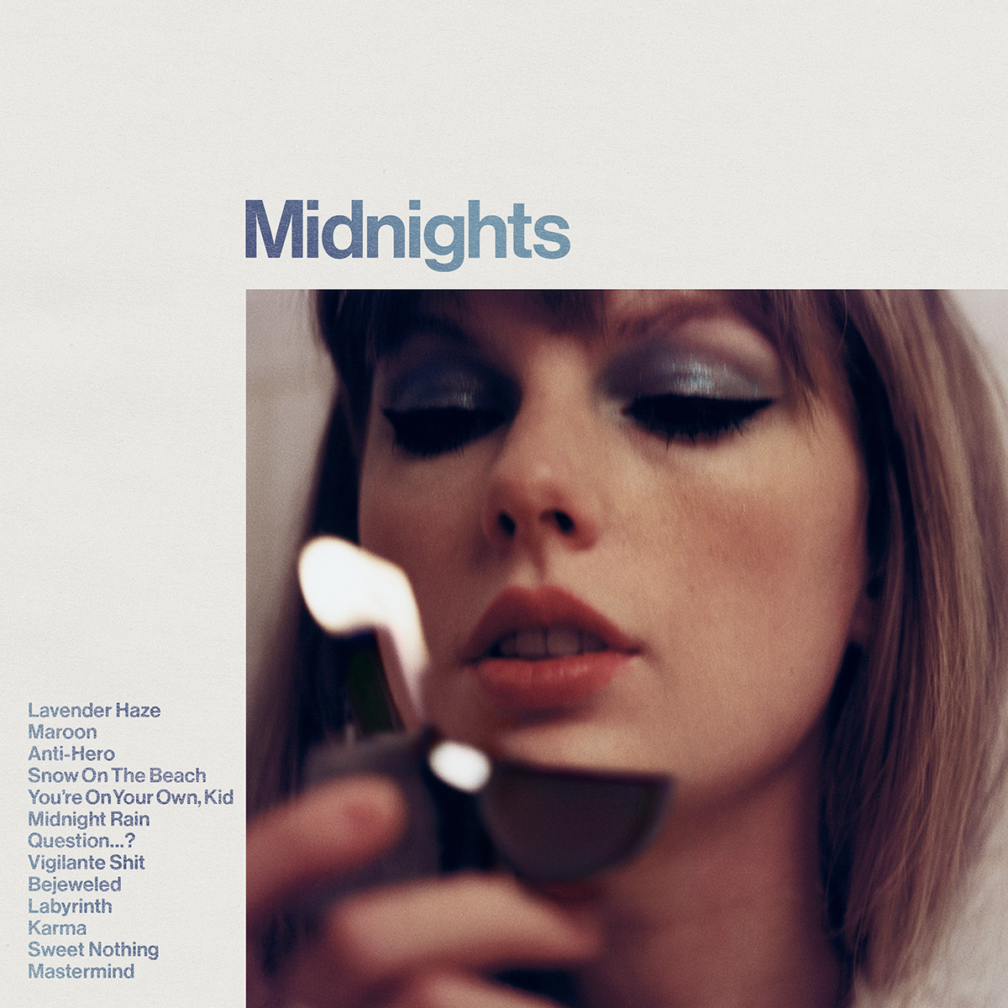
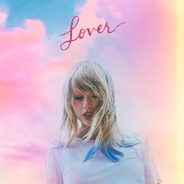


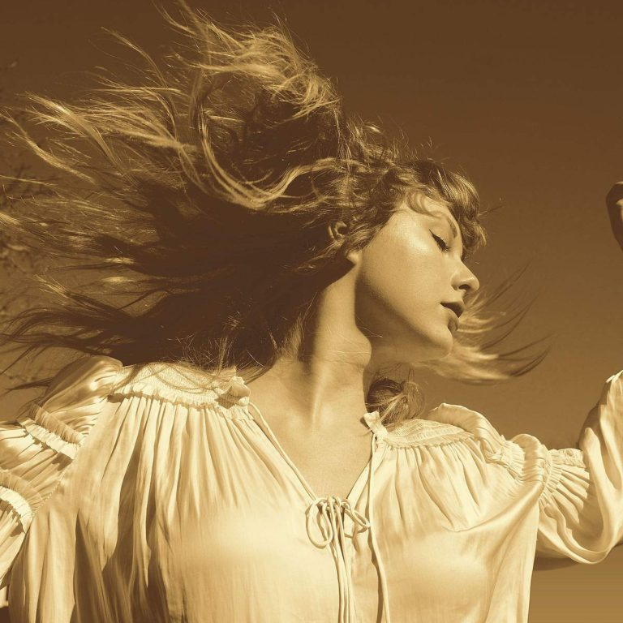
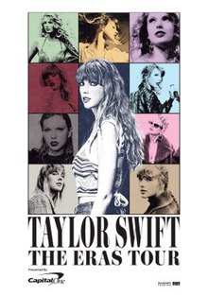
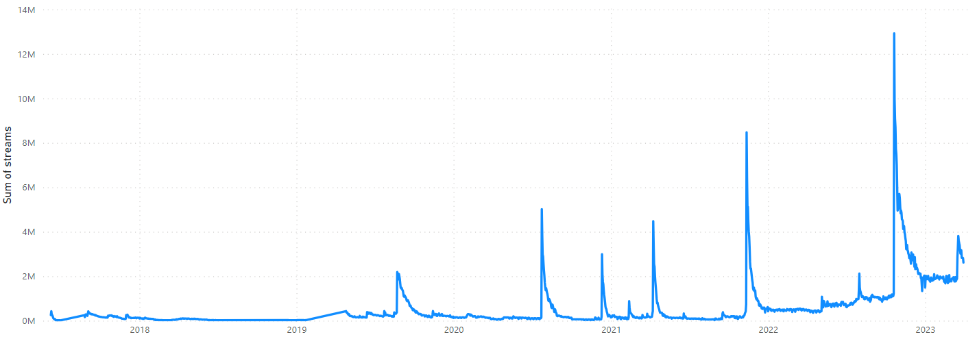
Carmi, a Swiftie, wanted to get a sense if certain actions by her idol Taylor led to more streaming activities.
November 12, 2021
October 21, 2022
August 23, 2019
July 24, 2020
December 11, 2020
March 17, 2023
April 09, 2021
August 01, 2022
February 12, 2021
Red (Taylor’s Version) Album Release
Total Streams: | 8,476,377
% increase: | 1053.85%
47 songs in Top 200 (Highest Rank: 1)
Midnights Album Release
Total Streams: | 12,926,945
% increase: | 955.45%
36 songs in Top 200 (Highest Rank: 1)
Lover Album Release
Total Streams: | 2,188,177
% increase: | 501.19%
18 songs in Top 200 (Highest Rank: 1)
Folklore Album Release
Total Streams: | 12,926,945
% increase: | 955.45%
25 songs in Top 200 (Highest Rank: 1)
Evermore Album Release
Total Streams: | 2,989,691
% increase: | 1425.16%
22 songs in Top 200 (Highest Rank: 1)
The Eras Tour Launch
Total Streams: | 2,861,142
% increase: | 52%
23 songs in Top 200 (Highest Rank: 3)
Fearless (Taylor’s Version) Album Release
Total Streams: | 4,476,141
% increase: | 924.49%
30 songs in Top 200 (Highest Rank: 1)
august streaming
Total Streams: | 2,120,585
% increase: | 49.90%
27 songs in Top 200 (Highest Rank: 1)
Fearless (Taylor’s Version) Album Announcement
Total Streams: | 880,686
% increase: | 482.66%
10 songs in Top 200 (Highest Rank: 1)
Total Streams in Daily Top Charts

Slide 3
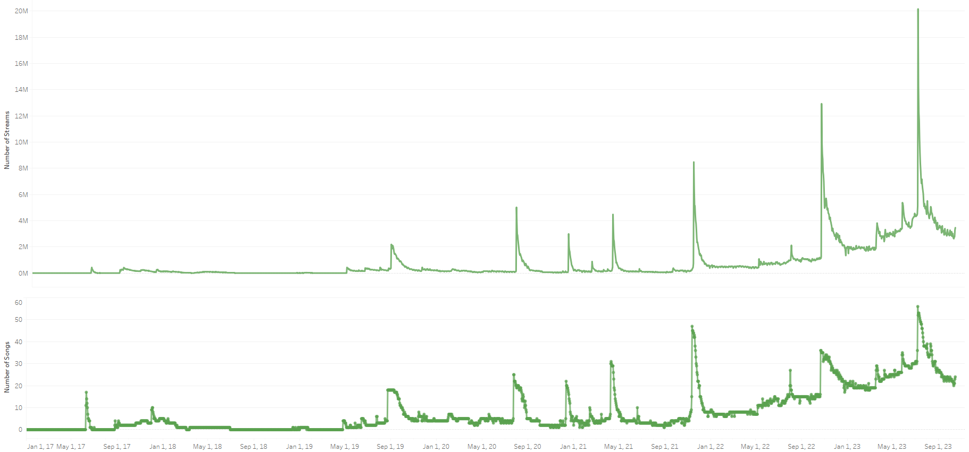

Slide 4
When the percent increase in daily streams is ranked, the top 20 includes the following:
8 happened during Album Release
4 happened during a Single Release
3 happened during an Album Announcement
2 happened during an Awards Ceremony
4 happened due to other circumstances*
*includes increase due to a seasonal track entitled august

Slide 5
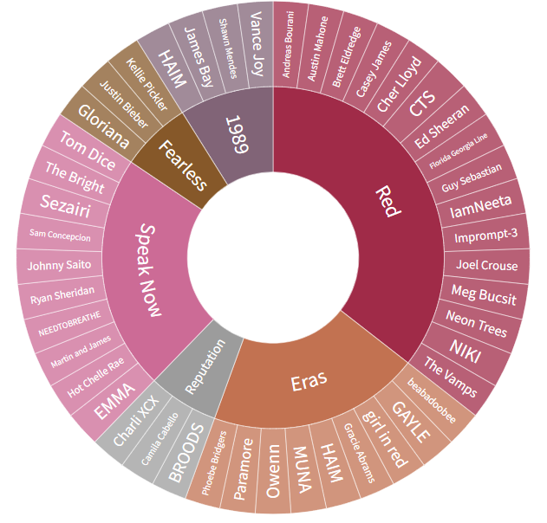
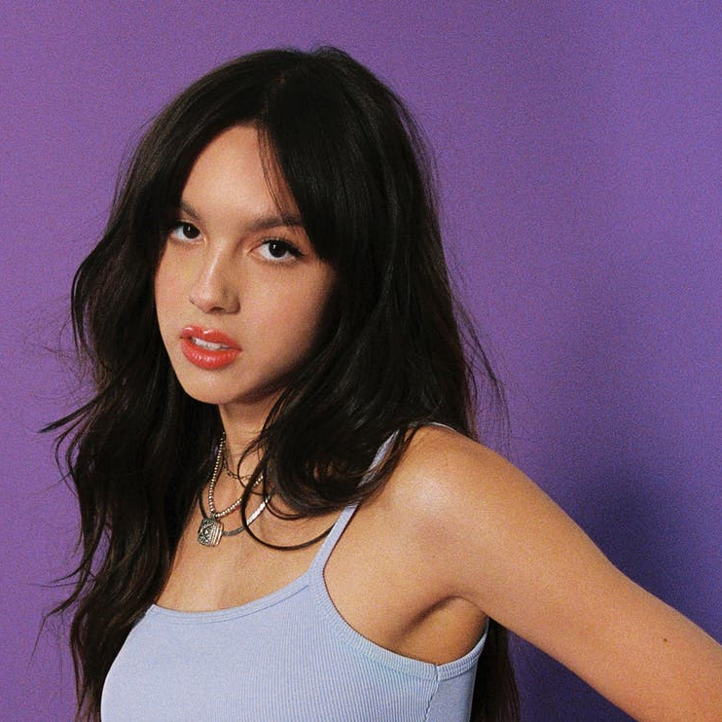
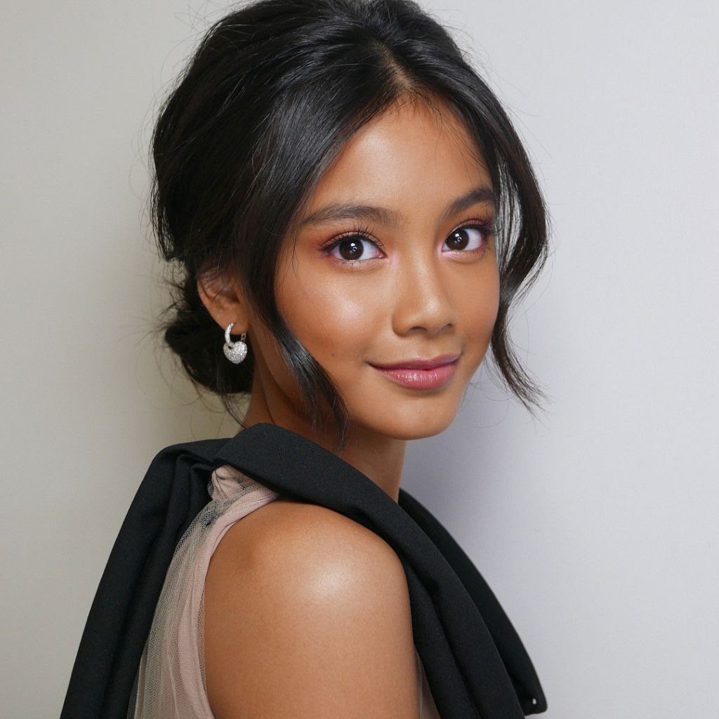
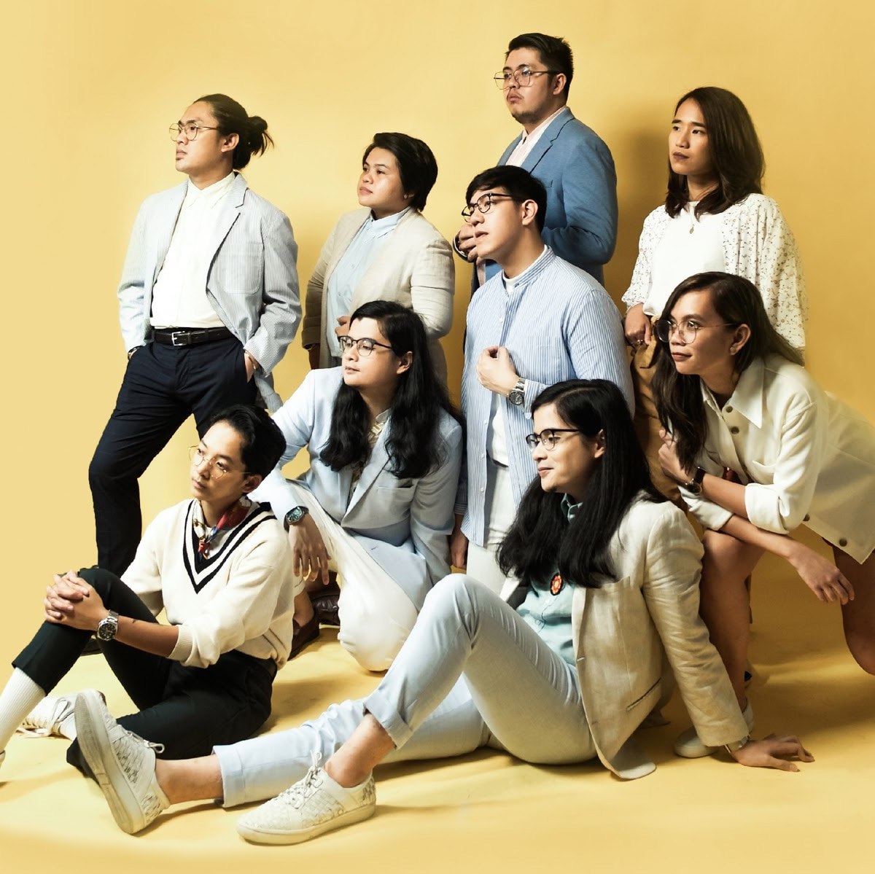
Are there certain Philippine artist/s who are better suited as front act for Taylor’s concert in the country should she decide to hold one here?
Olivia Rodrigo
Ylona Garcia
Ben&Ben
Main Genre: Pop
Followers: 24,755,114
Popularity Rank: 84
Can be grouped with other front acts like Sabrina Carpenter
Main Genre: Pop
Followers: 125,916
Popularity Rank: 46
Same label as another front act NIKI (88rising)
From: https://blog.chartmetric.com/exploring-taylor-swifts-opening-acts/
Based on the previous tours, the main genre that the front acts have is pop and majority of them also have songs written in the English language.
Main Genre: OPM
Followers: 24,755,114
Popularity Rank: 72
One of the most popular OPM band of the decade

Slide 6
Conclusion and Recommendation
Upon searching the history of Taylor’s front acts, Carmi will recognize that Taylor’s front acts mostly make pop songs. Also, Taylor is not really particular on the popularity of her front acts. Hence, some of the Filipino artists that may fit the criteria are Olivia Rodrigo (internationally popular), Ben&Ben (locally popular), and Ylona Garcia (indie/discovered artist).
Carmi can split Taylor Swift’s actions or announcements into categories and observe that aside from the release of the albums or singles itself, just the mere announcement of an upcoming album or being awarded also increases the daily top streams. It can also be worth noting that seasonal songs yearly causes an increase in the stream.

